Slide 1
LEGEND SPRINGS PTO
GENERAL MEETING
AUGUST 30, 2022

Slide 2
MEETING AGENDA
Call to Order
Approve Prior Meeting Minutes
Executive Board Introduction
PTO Info
Treasurer Report
Volunteer Plan
New Business
Audience Q&A
Adjourn

Slide 3
Approve Prior Meeting Minutes

Slide 4
Executive Board Introductions
Melanie Adams-Boyle
President
Cassie Woolgar
Vice President
Adrian Brown
Treasurer
Secretary
Jessica Black
Business Partnerships
Lou Toth
Business Partnerships
Rochelle McEwen
Membership
Karen Stephenson
Marketing & Social Media

Slide 5
Membership Update

Slide 6
Secretary Vacancy
Position Duties
Take and record meeting minutes
Prepare the meeting agenda with the President
Send notices of meetings to the membership
Keep copy of minutes, bylaws, rules, membership list at meetings
Nominations
LS E-mail/Text IT issues
Decision to vote via member e-mail list

Slide 7
PTA/PTO Annual Events
Staff Appreciation Breakfast
Meet the Teacher Night Table
First Day Packet Stuffing
Restaurant Nights
Peter Piper
Chipotle
Chick-fil-a
Barros
Lou Malnati's Pizzieria (New this year)
Movie Night & Basket Raffle
Staff Appreciation Lunches
Veteran's Parade
Giving Tree
APEX Fundraiser
Teacher Appreciation Week
Father/Daughter Dance
Mother/Son Bingo

Slide 8
Treasurer's Report
2021-2022
Total Income: $129,106
Total Expenses: $117, 686
2022-2023 Budget
Total Income: $117,560
Total Expenses: $110,100

Slide 9
SHOW ME THE MONEY (2021)
INCOME
EXPENSES
Dance & Bingo
$7100
$2600
Teacher/Staff Appreciation
$4000
$5600
Movie Night & Basket Raffle
$4100
$600
Memberships
$4000
$1100
Restaurant Nights
$4000
Donations
$4000
Spirit Gear Sales
$3100
$850
Box Tops/Fry's/Amazon Smile
$2600
$2500
$5000
$7500

Slide 10
10% Back to Teachers
$7370
APEX Fundraiser (2021)
PTO
$10,000
A total of $96,044 raised.
Payment to Apex
$39,155
Donation to LS
$40,000

Slide 11
Donations to LS
Other PTO Expenses
APEX - $40000 (2021)
STEM technology
Microscopes
Shade structure
APEX 10% Back to Teachers - $7300 (2021)
IXL Subscription - $7100 (2022)
Raz Kids Subscription - $3200 (Biannual - 2023)
Staff Back to School Supplies - $2300 (2022)
End of School Rita's Ice - $1350 (2021)
Card Reader Processing Fees - $625
PTO Insurance - $370
Tax Preparation - $300

Slide 12
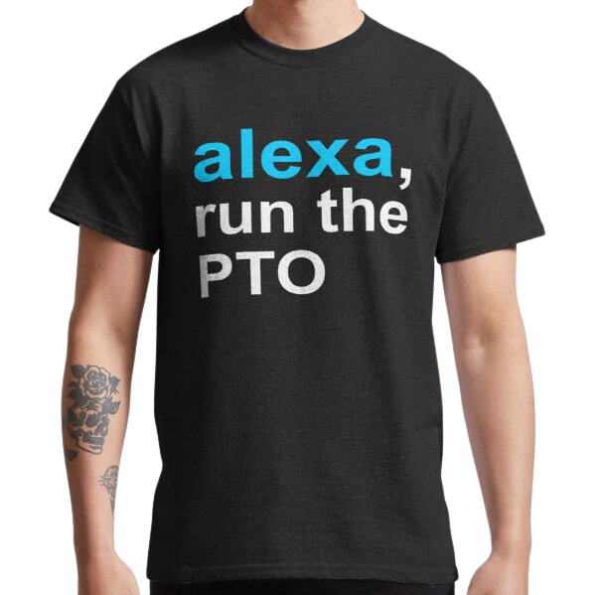
Volunteer Plan
Movie Night Planning, Set up, Event Night (October 21)
Fundraising
Basket Raffle & Silent Auction (happens with movie night)
Bring all other ideas!
Veteran's Parade (November 10)
Giving Week (December 12-16)
Father/Daughter Dance Planning, Set up, Event Night (March 31)
Teacher/Staff Appreciation
Lunches throughout the year
Teacher Appreciation Week (May 1-5)
Mother/Son Game Night Planning, Set up, Event Night (May 12)
Bulletin Board & Signage
MPR 15'x8' Board Monthly
Staff Lounge Decor
Help with Beginning of the Year events 2023
Teacher/Staff Back Breakfast
Tears and Cheers
Meet the Teacher Nights

Slide 13
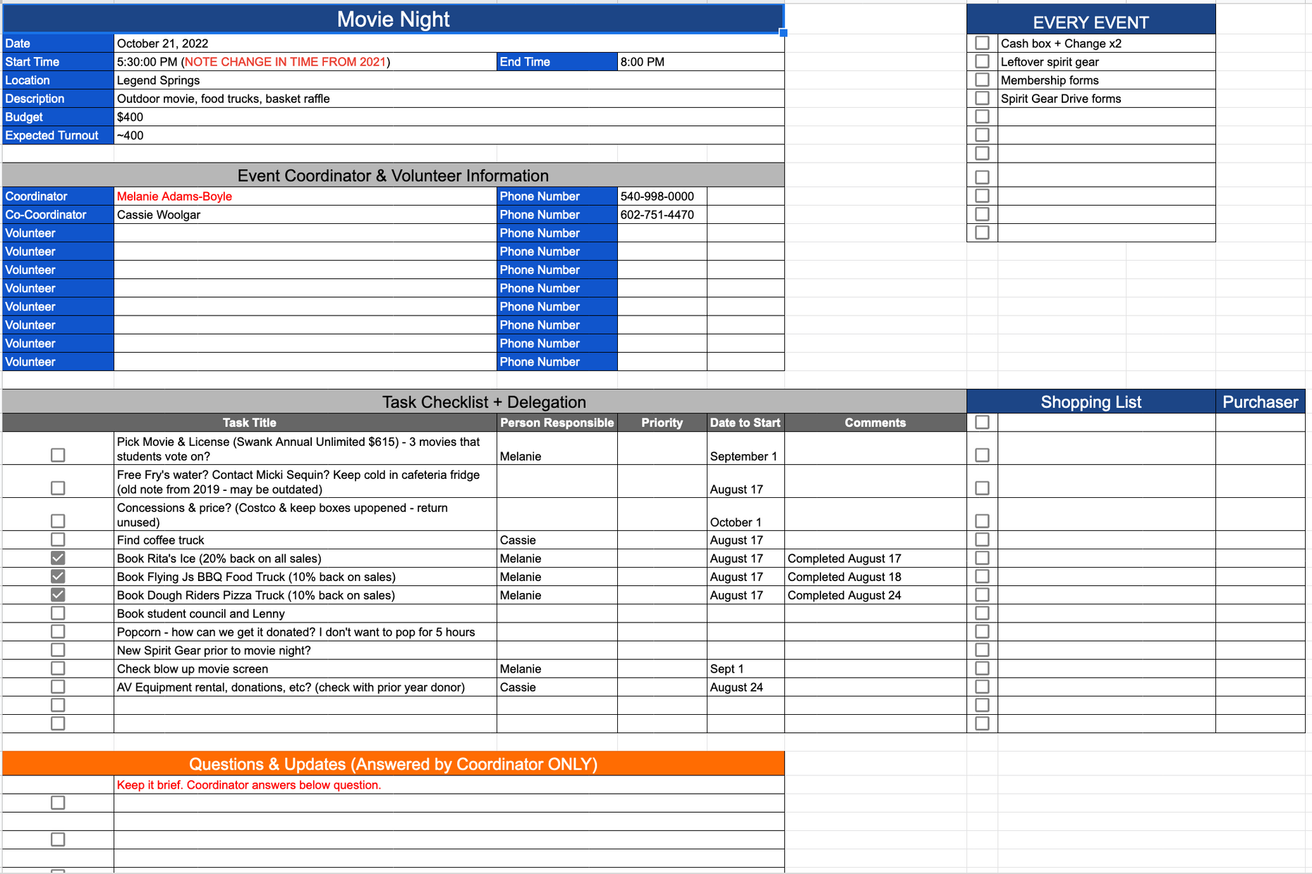
Volunteer Communication Plan

Slide 14
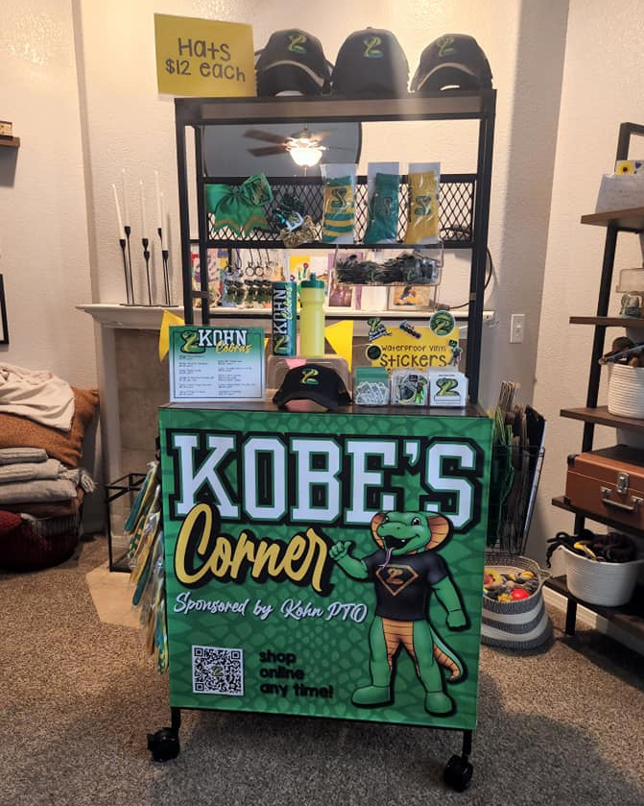
New Business
Spirit Gear Company - BSN Sports
Spirit Cart (Vote on $1500 Budget)
Fall Sports Night (Possible)
Sports groups in the area (i9, ASC, Arrowhead Lacrosse, etc)
Food Trucks
Lawn Games
Sponsor Tables

Slide 15
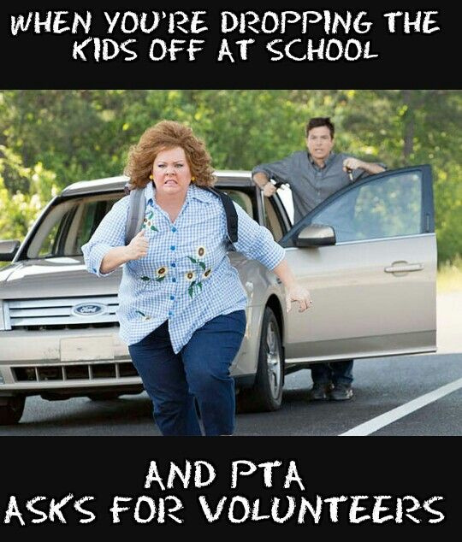
Questions & Comments
Raffle Winner Announcement
Adjourn Meeting
Thank you for coming!
O

