Slide 1
LEGEND SPRINGS PTO
GENERAL MEETING
March 1, 2023

Slide 2
MEETING AGENDA
Call to Order
Old Business
Approve Prior Meeting Minutes
Treasurer Report
APEX Wrap-Up
Lego Minifig Update
Spirit Gear
Basl Birthday
Watch Dogs
New Business
Financial Requests
Mr. Craig Golf Cart
Library Movie License
DVUSD Business Partner Meeting Update
Father-Daughter Dance
Open Forum
Raffle for Spring Training Tickets

Slide 3
Approve Prior Meeting Minutes

Slide 4
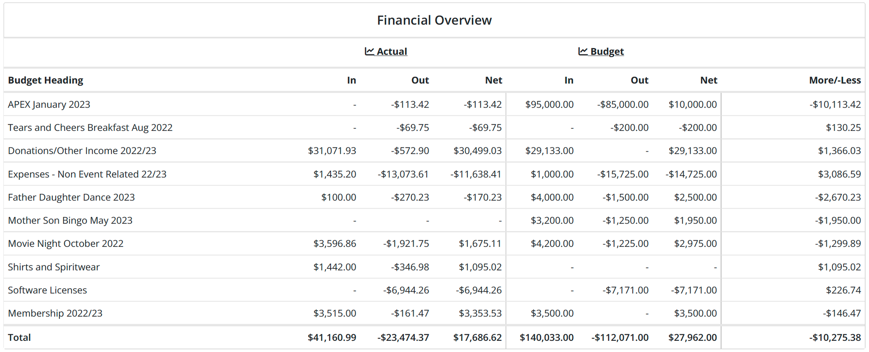
Treasurer's Report
Budget Review
Community Game Night
170.23
Account Balance: $79,752.01 ($18,028.98 without APEX)

Slide 5
Treasurer's Report
Remainder of Year Income
Father-Daughter Dance $2500
Mother-Son Bingo $1950
STEAM Shirts ?
Give Back Nights ~$1000
$5450
Remainder of year Expenses
BMX Show $2097
Appreciation Week $2500
End-of-School Treat (Rita's?) $1350
$5947

Slide 6
APEX Wrap Up

Slide 7
LEGEND SPRINGS ELEMENTARY
$61,7 23.03
100%
1,992
S.T.E.M, school Improvements, and social and emotional learning
180
300
30 X 6 LESSONS/CLASS
# of hours Apex teams spent running the program and making a positive impact at the school
Total Obstacles
25,788
81
STUDENTS REACHED
$10/Obstacle
For every student that reaches $10/Obstacle in pledges, Apex makes a donation to Feeding America to help provide up to 20 meals to those in need.
28%
48
[72%]
@
apexleaderco

Slide 8
APEX Wrap Up
Total Raised: $99,553.27
School Profit: $61,723.03
Teacher Portion: $6,172
APEX Portion: $37,830.24

Slide 9
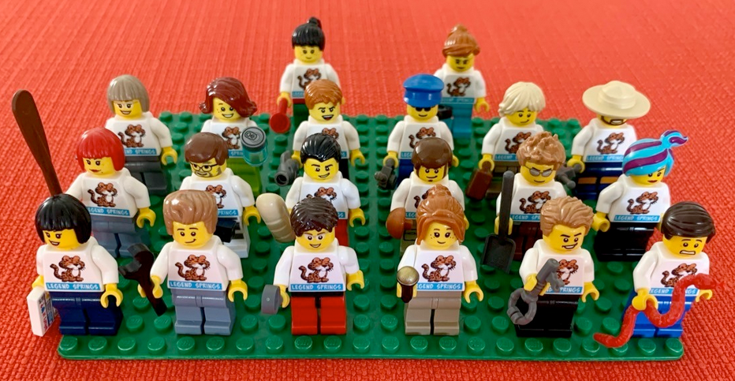
Lego Minifigs
Award Raffle Prize
Bricks & Minifigs N. Phoenix
Inventory on hand?

Slide 10
SPIRIT GEAR
STEAM Shirts
Bulk Order
Options
Art Locker

Slide 11
Mrs. Basl's Birthday
Let's Party Like It's 1983

Slide 12
WatchD.O.G.S.
Intro Event Complete
Calendar release next week
T-Shirts

Slide 13
New Business
Staff Requests
Mr. Craig Golf Cart - $300
Movie License Reimbursement - $160

Slide 14
DVUSD Business Partner Meeting Update
Alex Louis, Secretary

Slide 15
Father-Daughter Dance Update
Cassie Woolgar, VP

Slide 16
Upcoming Events
March
1: Basl Birthday
20: Perfection on Wheels Anti-Bullying BMX Bike Show
23: Jet's Give Back Night
31: Daddy-Daughter Dance
April
12: Chipotle Give Back Night
Possible Great Skate Night
May
1-5: Teacher Appreciation Week
4: Peter Piper Give Back Night
12: Mother-Son Game Night

Slide 17
VOLUNTEER ROUND UP
SignUp.com
Annual list of opportunites

Slide 18
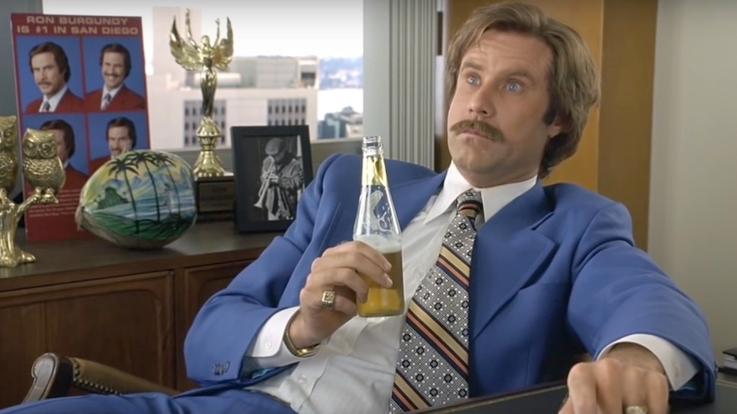
Questions & Comments
The PTO? I've heard of them. Crazy gangsters.
You have to change your identity to get out.

