Slide 1
LEGEND SPRINGS PTO
GENERAL MEETING
April 5, 2023

Slide 2
MEETING AGENDA
Call to Order
Old Business
Approve Prior Meeting Minutes (February & March)
Treasurer Report
Daddy-Daughter Dance Recap
Spirit Gear
New Business
Upcoming Events
Zeffy
Kindergarten Turf Quotes
Silent Auction
Nurse Jamie Care Basket
Teacher Appreciation Week
Board Elections for 23-24
Open Forum
Raffle for Crayola Experience Tickets and Element Cheer Passes

Slide 3
Approve Prior Meeting Minutes
(February & March)

Slide 4
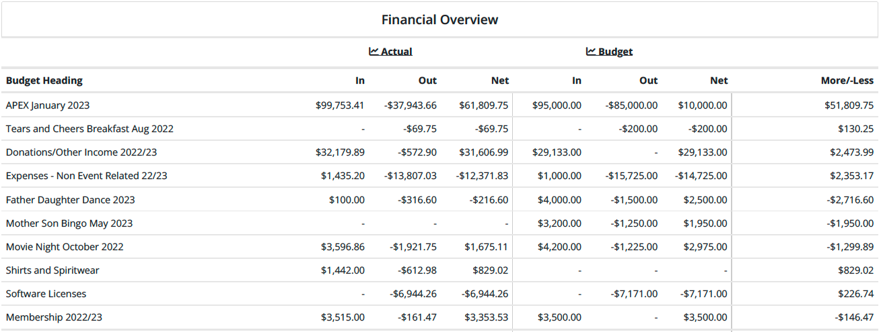
Treasurer's Report
Budget Review
Account Balance: $81,725.19 ($29,915.44 without APEX)

Slide 5
Treasurer's Report
Remainder of Year Income
Mother-Son Bingo $1950
Give Back Nights ~$1000
$2950
Remainder of year Expenses
Teacher Appreciation Week $2500
End-of-School Treat (Rita's?) $1350
Spirit Gear Bulk Order
$3850

Slide 6
Daddy-Daughter Dance Wrap Up
Income
~$4000
Expenses
$835

Slide 7
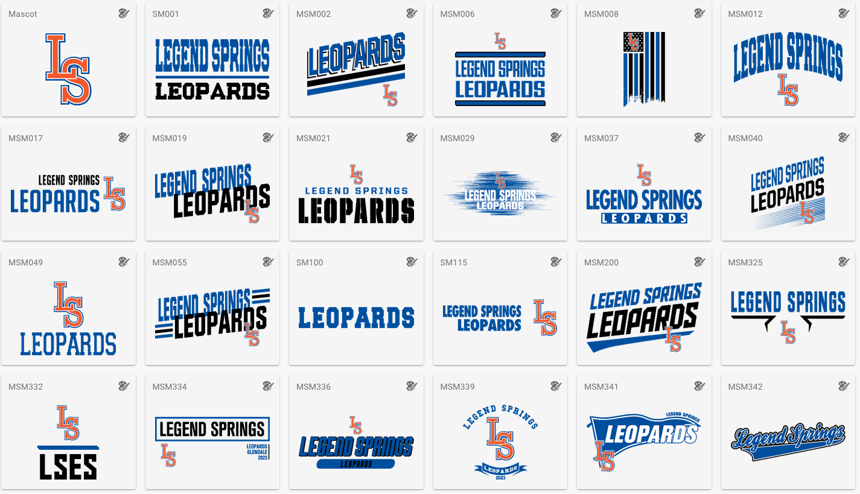
SPIRIT GEAR

Slide 8
New Business

Slide 9
Upcoming Events
April
12: Chipotle Give Back Night
May
1-5: Teacher Appreciation Week
4: Peter Piper Give Back Night
12: Mother-Son Game Night

Slide 10
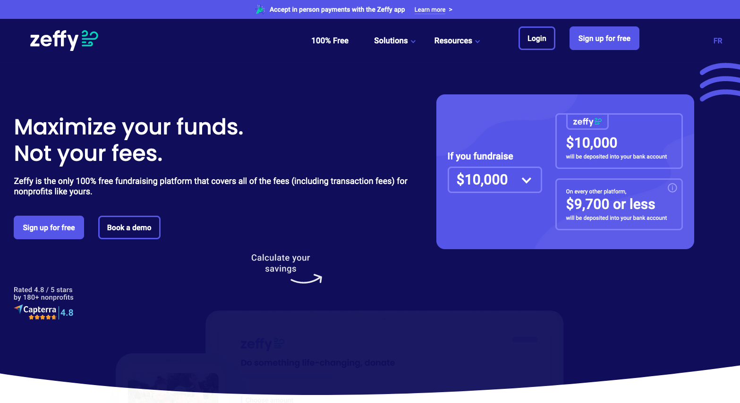
ZEFFY

Slide 11
Kindergarten Turf
MB Outdoor Services
$27,908
Arizona's Greenest Grass Turf Company
$47,533
Artifical Grass Masters
$26,703

Slide 12
Silent Auction
Platform
Auctria takes 1%
Build on our website?
Items
Run now through STEAM night

Slide 13
Nurse Jamie Care Package

Slide 14
Teacher Appreciation Week
Theme: Camping/Outdoors
Ideas
S'mores Bar
Camp Counselor Cart
Lunch - donation request sent
Baked Potato Bar
Lumberjack Breakfast

Slide 15
Board Member Elections
May Meeting
Campaign for potential board members
Posters?
Ideas to draw interest

Slide 16
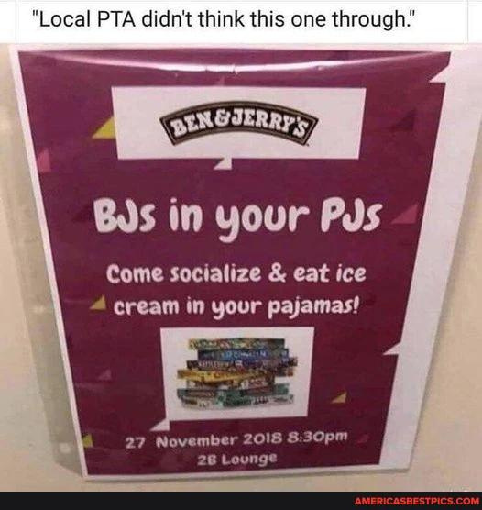
Questions & Comments

